Slide 1


M Jyothish Varma
29-01-25

Slide 2

Outline
Executive Summary
Introduction
Methodology
Results
Conclusion
Appendix

Slide 3
Executive Summary
Summary of methodologies:
1) Data Collection
2) Data Wrangling
3) Exploratory Data Analysis
4) Visual Analytics using Folium and Dash
5) Predictive Analysis
Summary of all results:
Various classification models were used for prediction like Logistic Regression, SVM and Decision Tree. Interestingly all the models gave similar accuracy of 83 percent.

Slide 4
Introduction
Project background and context
In this capstone, we will predict if the Falcon 9 first stage will land successfully. SpaceX advertises Falcon 9 rocket launches on its website with a cost of 62 million dollars; other providers cost upward of 165 million dollars each, much of the savings is because SpaceX can reuse the first stage. Therefore if we can determine if the first stage will land, we can determine the cost of a launch. This information can be used if an alternate company wants to bid against SpaceX for a rocket launch
Problems you want to find answers:
Various problems for I want to find answers with the help of this project are what are the success rates of various launch stations, success rate of Falcon 9 first stage, Impact of location on the success of the mission and many more.

Slide 5

Section 1

Slide 6
Methodology
Executive Summary
Data collection methodology:
The Data was collected with the help of SpaceX API and Wikipedia
Perform data wrangling
With the help of some functions the outcome feature was attached to the data
Perform exploratory data analysis (EDA) using visualization and SQL
Perform interactive visual analytics using Folium and Plotly Dash
Perform predictive analysis using classification models
Initially the data has been normalized and fitted into the various models, later the hyperparameters are fine tuned using GridSearchCV and finally evaluated using various metrics like Accuracy Score,R2 etc.

Slide 7
Data Collection
The dataset for this project is created by extracting launch data from the SpaceX API and additional details from the Wikipedia page on Falcon 9 and Heavy launches. The SpaceX API provides structured information, including launch dates, rocket types, payloads, and landing outcomes, which are crucial for predicting first-stage landings. Wikipedia helps supplement this data with historical launch records, mission details, and landing attempts, ensuring a more comprehensive dataset.
To collect the data, REST API calls are made to the SpaceX API endpoints, retrieving JSON responses that are then processed and stored. Web scraping techniques or manual extraction from Wikipedia ensure missing or additional details, such as mission descriptions, are included. The collected dataset is then cleaned and formatted, preparing it for exploratory data analysis and predictive modeling.

Slide 8
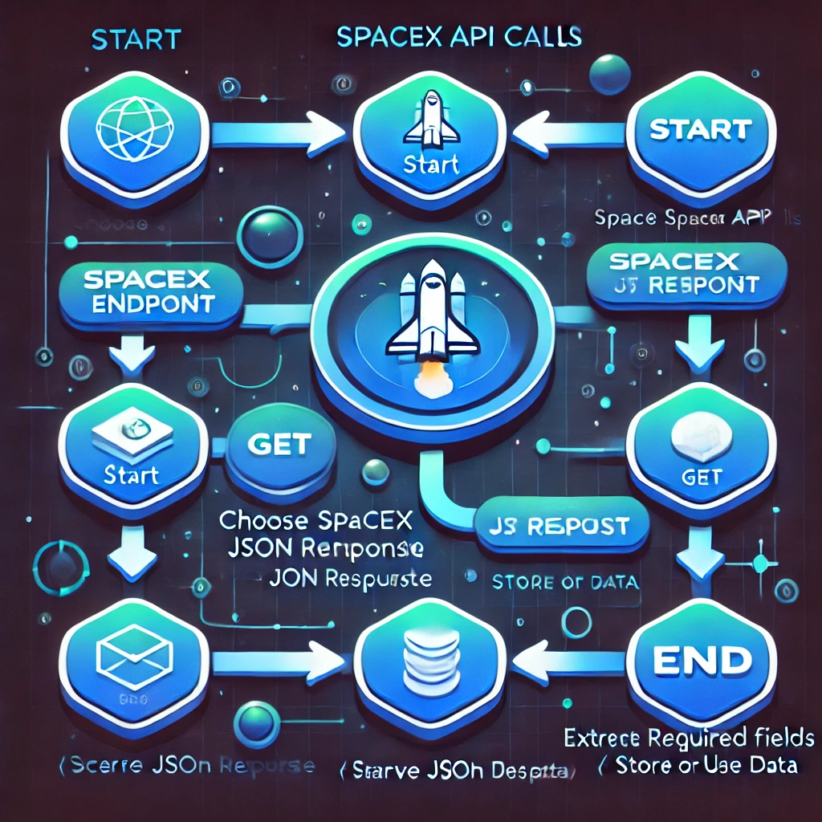
Data Collection – SpaceX API
GitHub link:- spacex_capstone/jupyter-labs-spacex-data-collection-api.ipynb at main · mjyothishvarma/spacex_capstone

Slide 9
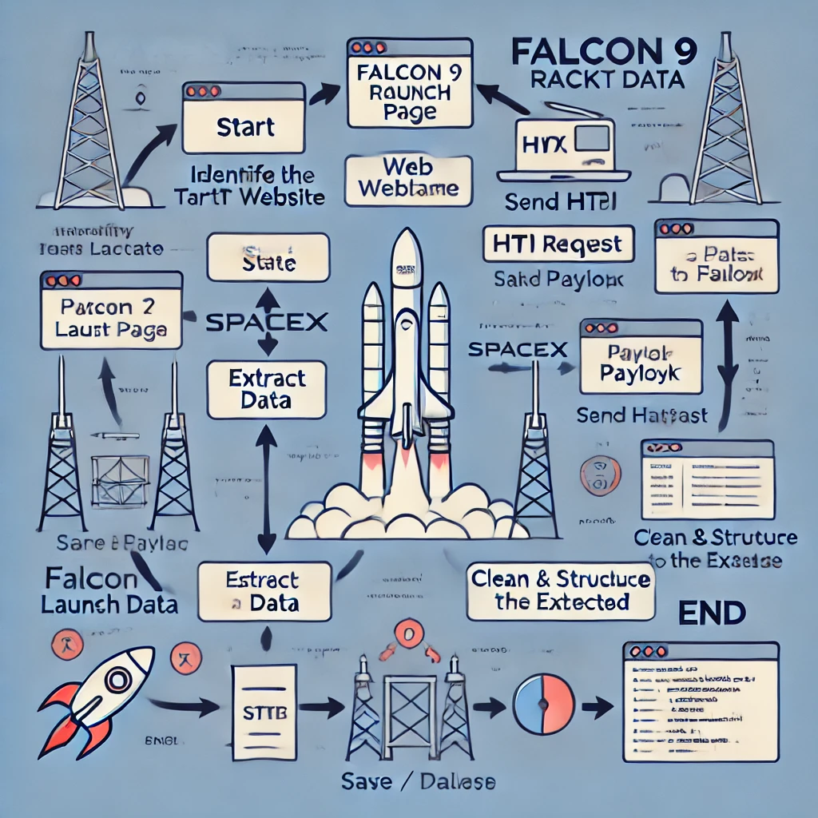
Data Collection - Scraping
GitHub:- spacex_capstone/jupyter-labs-webscraping.ipynb at main · mjyothishvarma/spacex_capstone

Slide 10
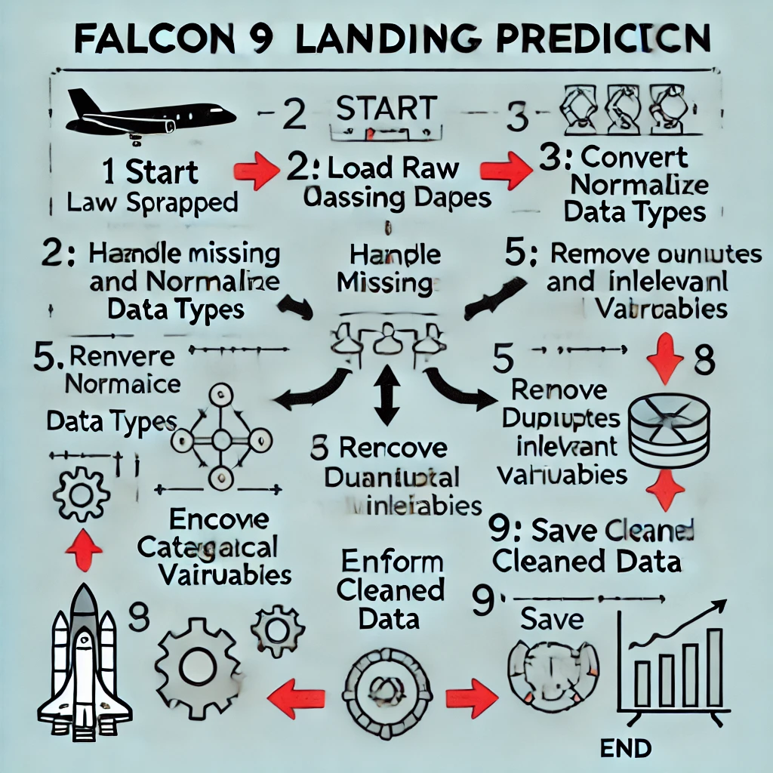
Data Wrangling
After web scraping the raw Falcon 9 launch data, data wrangling is essential to clean and prepare it for analysis. This involves handling missing values, converting data types, and normalizing numerical features. Duplicate or irrelevant entries are removed, and categorical variables like launch site or booster version are encoded for model compatibility. Feature engineering may also be performed to derive new insights from existing attributes. Finally, the cleaned data is stored in a structured format for further analysis and model training.
GitHub Link:- spacex_capstone/labs-jupyter-spacex-Data wrangling.ipynb at main · mjyothishvarma/spacex_capstone

Slide 11
EDA with Data Visualization
Summarize what charts were plotted and why you used those charts
Various charts like cat plots, line plots and bar charts were used. Cat plots like flight number vs pay load mass, flight number vs launch site, flight number and orbit type and pay load mass vs launch site were plotted to know how are various categories of each variable were split. Bar chart was plotted to know what is the success rate of each orbit and line plot of year vs success rate to know how time has affected the success rate of the launches.
GitHub URL :- spacex_capstone/edadataviz.ipynb at main · mjyothishvarma/spacex_capstone

Slide 12
EDA with SQL
There are in total four launch sites of the SpaceX organization.
The average payload mass carried by booster version F9 v1.1 is around 2928 kilograms.
2015-12-22 was the first successful landing outcome in ground pad.
There are around 12 boosters which have carried the maximum payload.
There were two drone ship failures from the site CCAFS LC-40 during the months January and April in the year 2015.
GitHub URL :- spacex_capstone/jupyter-labs-eda-sql-coursera_sqllite.ipynb at main · mjyothishvarma/spacex_capstone

Slide 13
Build an Interactive Map with Folium
In the project on the map we created and placed markers to know the location of the launches and created circles to know the count of the launches as it becomes difficult to count the markers individually and also we made some lines to show the distance between launch sites and various places like seashore, railway tracks and vegetation to know where these sites are generally constructed.
GitHub URL :- spacex_capstone/lab_jupyter_launch_site_location.ipynb at main · mjyothishvarma/spacex_capstone

Slide 14
Build a Dashboard with Plotly Dash
We made two types of plots, a bar chart and cat plot.
A bar chart for representing the success and failure of launch sites. Initially the graph shows the success rate of various launch sites and upon selection of the site it shows the success and failure rate of that particular site.
A cat plot for representing correlation between payload mass and success rate which comes with a slider to adjust the range of pay load mass.
GitHub URL :- spacex_capstone/dashboard.pdf at main · mjyothishvarma/spacex_capstone

Slide 15
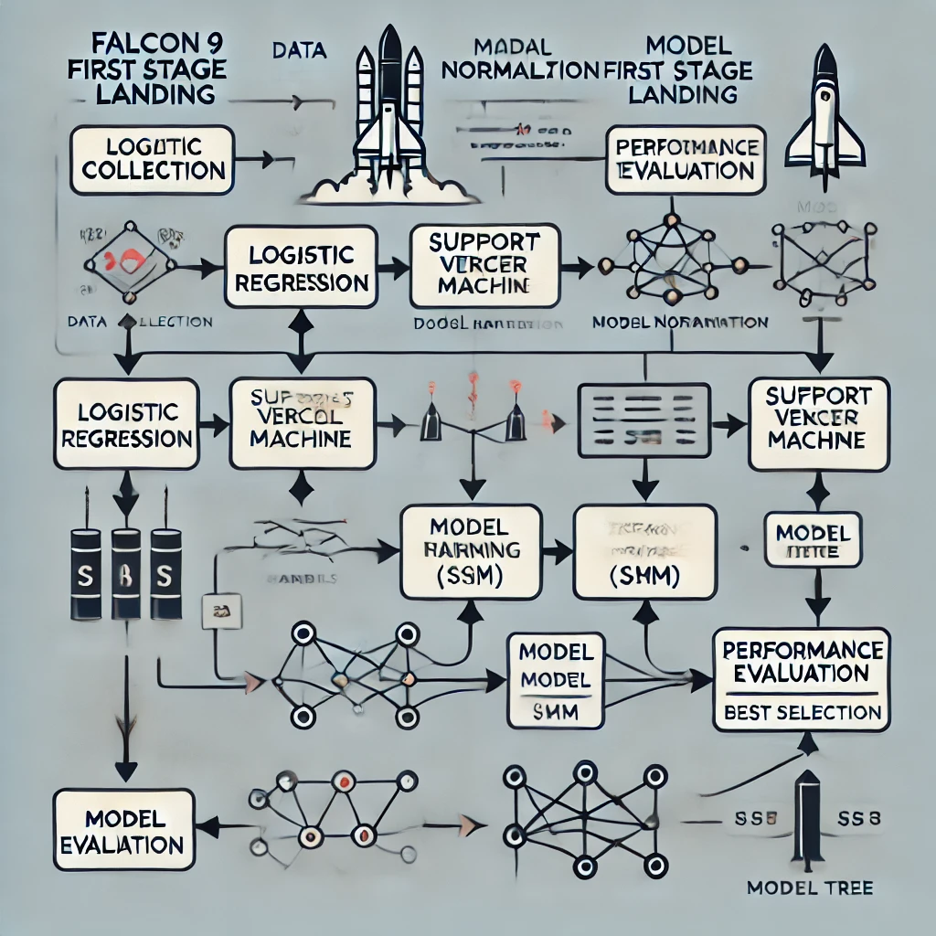
Predictive Analysis (Classification)
I first normalized the dataset to scale the features, ensuring that the model performance would not be biased by differing feature magnitudes. Then, I applied three different machine learning models: Logistic Regression, Support Vector Machine (SVM), and Decision Tree, to predict whether the first stage would land successfully. Each model was trained on the normalized data, and their performance was evaluated based on their ability to correctly classify the landing status. The models were selected to compare their predictive accuracy and robustness. By analyzing the results, we can determine the best model for predicting Falcon 9's landing success.
GitHub Link :- spacex_capstone/SpaceX_Machine Learning Prediction_Part_5.ipynb at main · mjyothishvarma/spacex_capstone

Slide 16
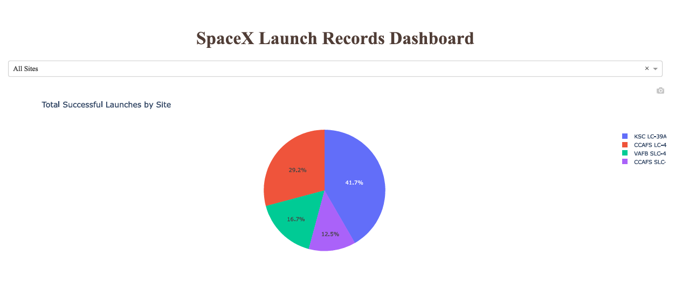
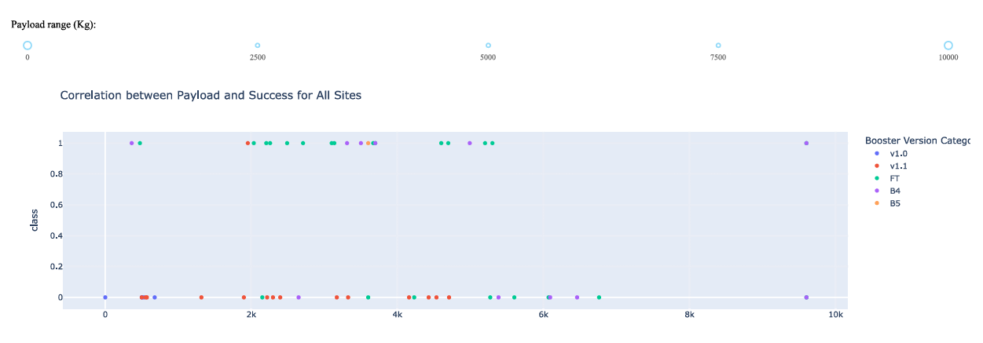
Results
The exploratory data analysis revealed that key features like rocket mass, and launch site significantly influence the likelihood of a successful Falcon 9 first-stage landing. Visualizations showed strong correlations between successful landings and favorable Falcon 9 features.
The predictive model achieved an accuracy of over 80% in classifying successful landings, with all the models performing well. Hyperparameter tuning further enhanced model performance, providing valuable insights into the likelihood of success based on launch variables.

Slide 17

Section 2

Slide 18
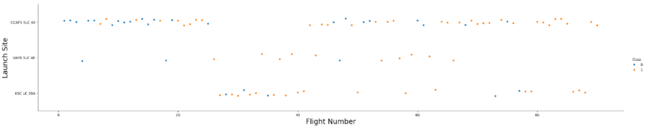
Flight Number vs. Launch Site
Most of the flights have been launched at CCAFS SLC 40 or KSC LC 39A.

Slide 19
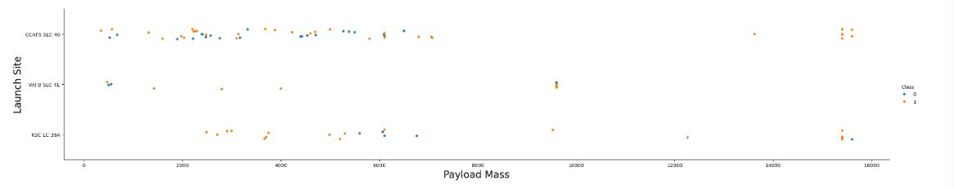
Payload vs. Launch Site
We can observe Payload Mass Vs. Launch Site scatter point chart you will find for the VAFB-SLC launch site there are no rockets launched for heavy payload mass(greater than 10000).

Slide 20
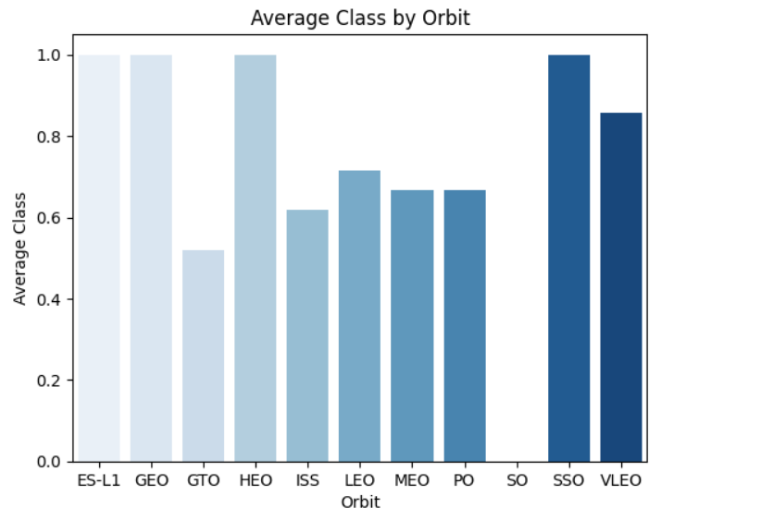
Success Rate vs. Orbit Type
The orbits ES-L1,GEO,HEO and SSO have 100% success rate.

Slide 21
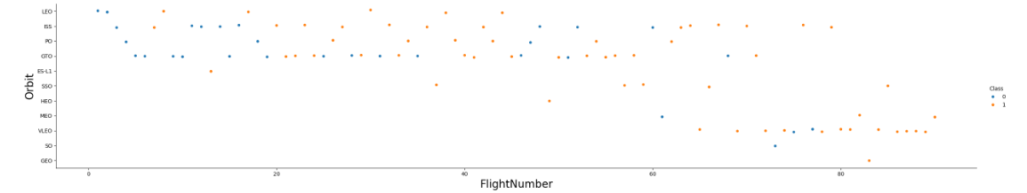
Flight Number vs. Orbit Type
You can observe that in the LEO orbit, success seems to be related to the number of flights. Conversely, in the GTO orbit, there appears to be no relationship between flight number and success.

Slide 22
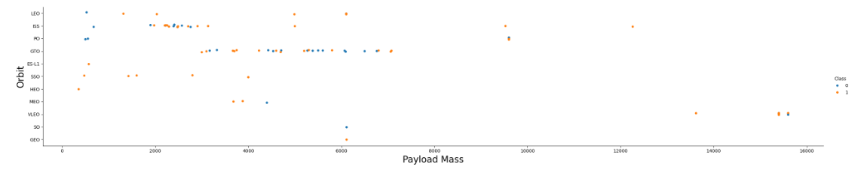
Payload vs. Orbit Type
With heavy payloads the successful landing or positive landing rate are more for Polar,LEO and ISS. However, for GTO, it's difficult to distinguish between successful and unsuccessful landings as both outcomes are present.

Slide 23
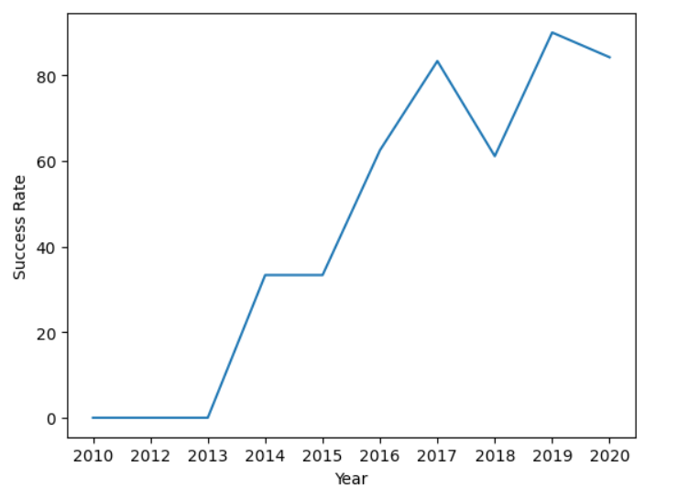
Launch Success Yearly Trend
We can observe that the success rate since 2013 kept increasing till 2020.

Slide 24
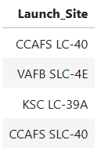
All Launch Site Names
These are the four different launch sites.

Slide 25
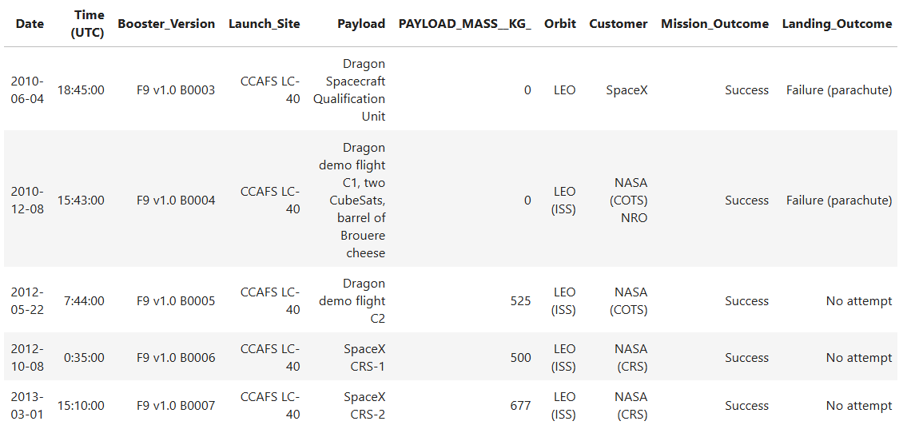
Launch Site Names Begin with 'CCA'
These are 5 details of flights with launch sites whose names begin with ‘CCA’, they are to identify form the site CCAFS LC-40

Slide 26
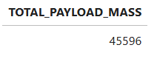
Total Payload Mass
The total payload mass carried by boosters launched by NASA (CRS) is around 45596 kilograms.

Slide 27
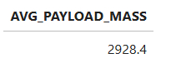
Average Payload Mass by F9 v1.1
The average payload mass carried by booster version F9 v1.1 is 2928.4 kilograms.

Slide 28
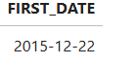
First Successful Ground Landing Date
The date when the first successful landing outcome in ground pad was achieved was on 2015-12-22

Slide 29
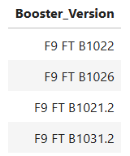
Successful Drone Ship Landing with Payload between 4000 and 6000
These are the names of boosters which have successfully landed on drone ship and had payload mass greater than 4000 but less than 6000

Slide 30
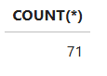
Total Number of Successful and Failure Mission Outcomes
The total number of successful and failure mission outcomes is 71.

Slide 31
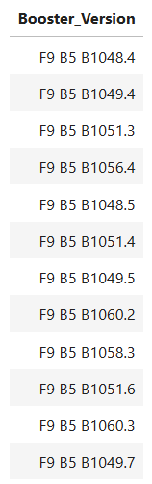
Boosters Carried Maximum Payload
These are the names of the booster which have carried the maximum payload mass

Slide 32
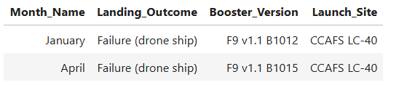
2015 Launch Records
These are the two failed landing outcomes in drone ship, their booster versions, and launch site names for in year 2015. One occurred in January and the other in April.

Slide 33
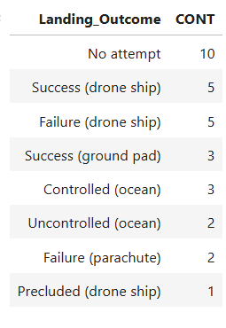
Rank Landing Outcomes Between 2010-06-04 and 2017-03-20
The above table consists of ranks of the count of landing outcomes (such as Failure (drone ship) or Success (ground pad)) between the date 2010-06-04 and 2017-03-20, in descending order.

Slide 34

Section 3

Slide 35
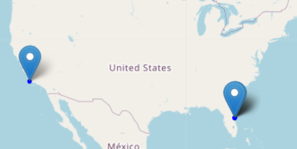
Folium Map With Marked Launch Sites
There are total four launch sites represented by markers, one marker to the left and three overlapped markers on the right because of their proximity.

Slide 36
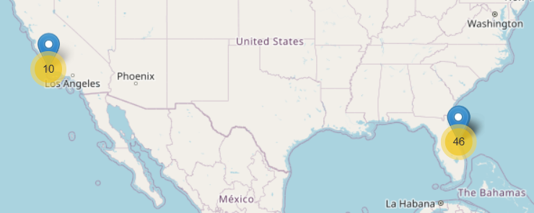
Folium Map with Marker Clusters
Marker clusters tells about the number of launches form the particular launch site. On clicking the marker cluster we can also see red and green clusters representing successful and failed launches.

Slide 37
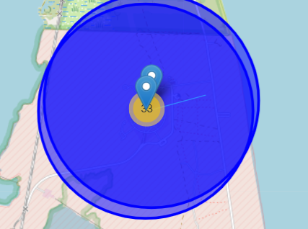
Folium Map with Lines
The folium map shows the screenshot of a selected launch site to its proximities such as railway, highway, coastline. This helps us to understand where are launch sites in general located close to.

Slide 38

Section 4

Slide 39
Successful Launches by Site
Most successful launches has been done at KSC LC-39A and least at VAFB SLC-4

Slide 40
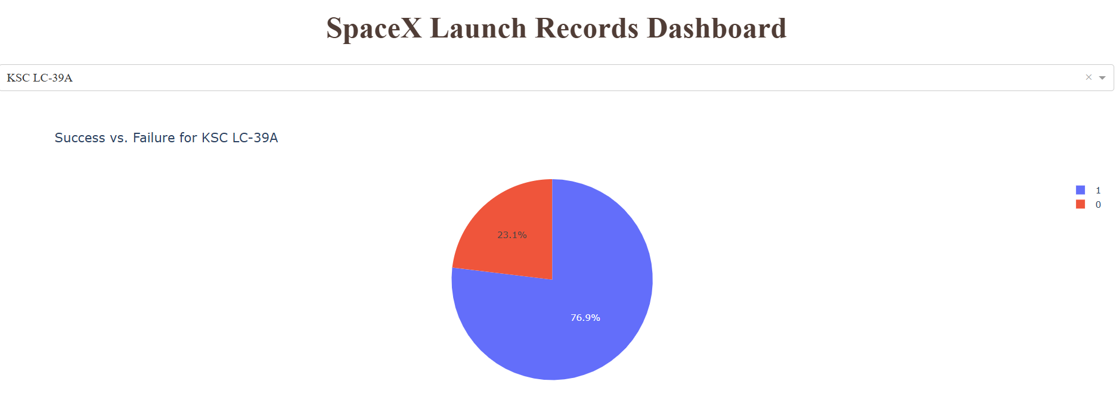
Success Data of Most Successful Site
The site KSC LC-39A has 76.9 % success rate.

Slide 41
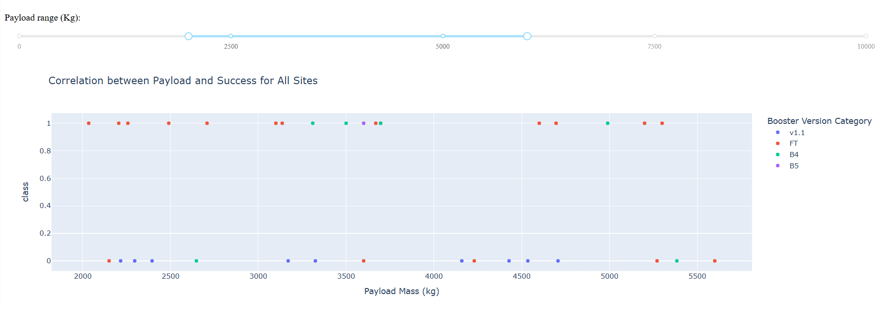
Correlation between Payload and Success Rate
For the range 2000-5500 the flights with booster version FT has high success rate.

Slide 42

Section 5

Slide 43
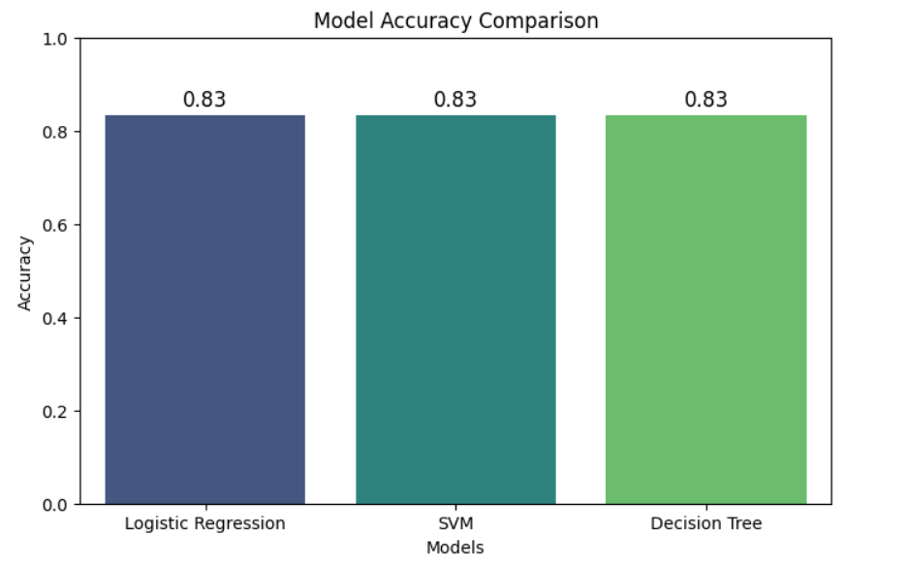
Classification Accuracy
All the models have performed equally good with accuracy around 83.3%

Slide 44
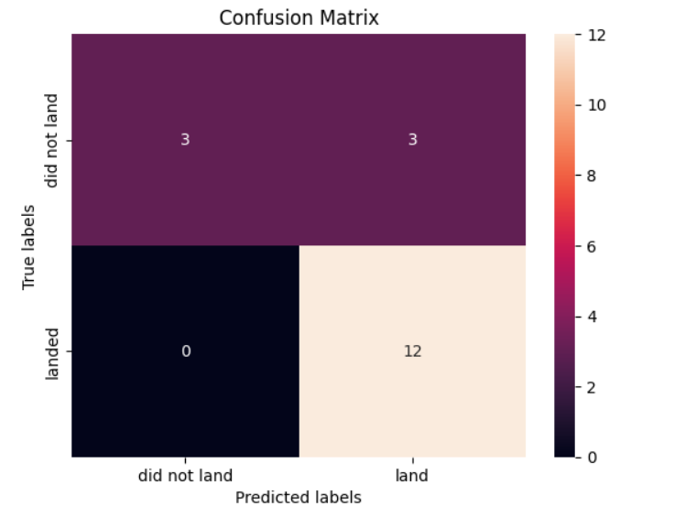
Confusion Matrix

Slide 45
Conclusions
Feature Importance: Weather conditions, booster version, payload mass, and launch site significantly impact the success of the first-stage landing.
EDA Insights: Successful landings are more frequent under favorable weather conditions and at specific landing zones, highlighting optimization opportunities.
Model Performance: Logistic Regression, SVM, and Decision Tree models all achieved an accuracy of 83.33%, showing that landing success can be predicted with reasonable confidence.
Reusability and Cost Savings: Predicting landings helps assess booster reuse potential, contributing to significant cost reductions in rocket launches.
Competitive Advantage: Accurate predictions can aid alternate companies in competing with SpaceX by evaluating launch costs and success probabilities.
Future Improvements: Incorporating real-time sensor data and deep learning techniques could further enhance prediction accuracy and reliability.

Slide 46
Appendix
Include any relevant assets like Python code snippets, SQL queries, charts, Notebook outputs, or data sets that you may have created during this project

Slide 47


